Slide 1
Presentation of MSc Thesis in Artificial Intelligence
and Data Analytics
Christina Tzogka
Supervisor: Ioannis Refanidis

Slide 2
Title:
ADDRESSING COMPUTER VISION CHALLENGES USING AN ACTIVE LEARNING FRAMEWORK

Slide 3
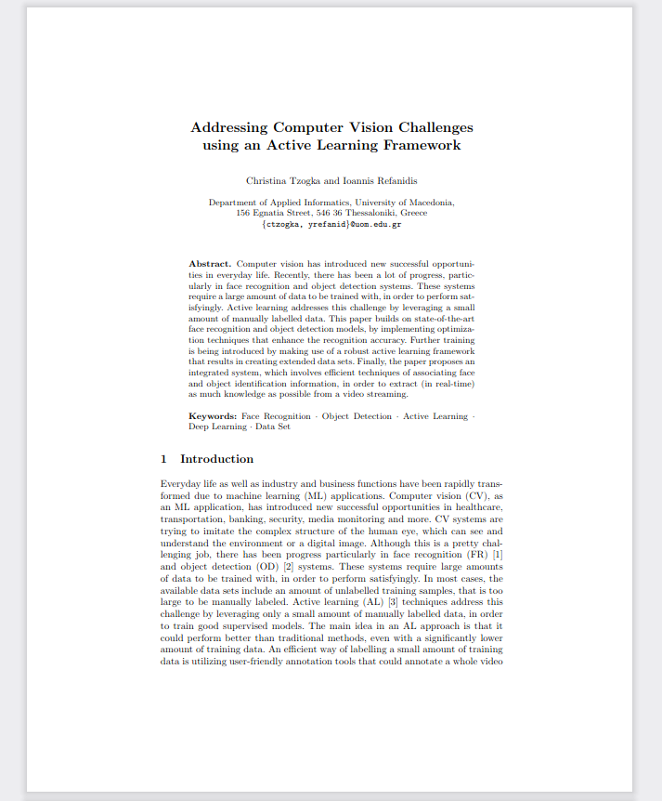

Slide 4
Abstract
Computer Vision (CV), as a Machine Learning application, has introduced new successful opportunities in healthcare, transportation, media monitoring and more.
Although this is a pretty challenging job, there has been progress particularly in Face Recognition (FR) and Object Detection (OD) systems.
These systems require large amounts of data to be trained with in order to perform satisfyingly. In most cases, the available data sets include an amount of unlabelled training samples, that is too large to be manually labeled.
Active Learning (AL) techniques address this challenge by leveraging only a small amount of manually labelled data, in order to train good supervised models.
An efficient way of labelling a small amount of training data is utilizing user-friendly annotation tools that could annotate a whole video streaming and export the labelled data.

Slide 5
The goal of this thesis is to:
provide a comprehensive study on FR and OD state-of-the-art open-source models;
introduce sophisticated training processes as well as optimization methods that enhance the results' accuracy;
propose a robust Active Learning method of creating extended data sets utilizing interactive annotation tools ;
provide efficient techniques of associating FR and OD outputs thought a workflow, in order to extract as much knowledge as possible from an input video.
Furthermore, we introduce the implementation of a detailed metadata repository that includes information for the input's features (e.g duration, resolution etc) as well as frames contents (that is, faces and objects) that the integrated system has detected.
The metadata repository enables the access to the whole extracted information and the further associations between the FR and OD individual outputs.

Slide 6
Computer Vision: State-of-the-art Review
Face Recognition:
In 2015, Google announced FaceNet, which achieved a new record accuracy of 99.63% on the widely used LFW dataset.
At the same time, OpenFace was being released. OpenFace is an open-source implementation, inspired by FaceNet.
Dlib is an open-source face recognition built (part of OpenFace), using Deep Learning (DL) and achieving state-of-the-art performance.
The model responsible for actually quantifying each face in an image has an accuracy of 99.38% (on LFW).
Object Detection:
ImageAI supports a list of state-of-the-art Machine Learning models for OD (e.g YOLOv3).
YOLOv3 has been trained on COCO dataset and recognizes 80 different objects in images and videos.
The YOLOv3 model uses DL and achieves a 63.7% mAP score over the 2007 PASCAL VOC dataset while it allows real-time predictions.
YOLOv3 could be 4 times faster and certainly more convenient to use in comparison to other well-performed models such as Faster R-CNN and Mask R-CNN that are not implementable for real-time.

Slide 7
Face Recognition with DLIB
The full FR workflow consists of the following processes:
Face Detection: locates the faces in an image before passing them to the next step.
Face Preprocessing: (i.e rotation, scaling, transformation) all faces are being warped so that their eyes and lips lie always in the same direction.
Feature Extraction: extraction of basic measurements (e.g encodings 128-d) from each face, in order to enable comparisons between different faces.
Face Recognition: ML classification algorithm (e.g SVM, KNN) is being used in order to find the person in the dataset who has the smallest encodings difference from the test sample.

Slide 8
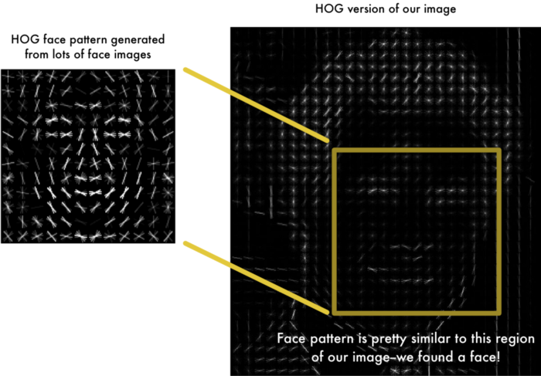
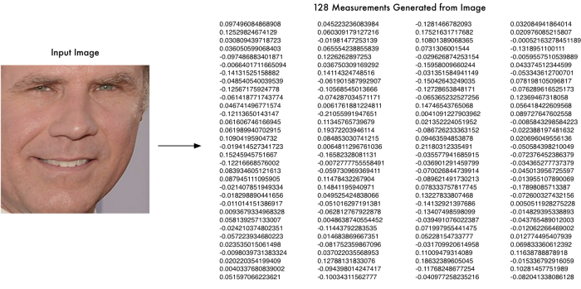
2. Face Pre-processing
1. Face Detection
3. Face Encodings
Face Recognition Workflow

Slide 9
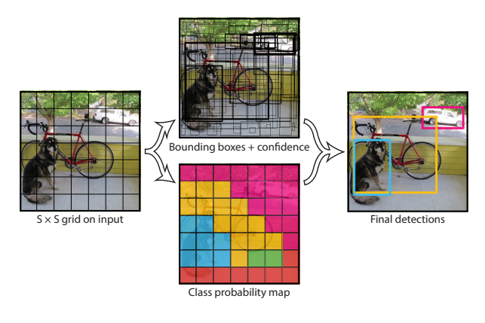
Object Detection with YOLOv3
YOLOv3 is very fast and well-performed due to the technique that it follows.
It detects objects by forwarding the whole image only once through the network.
On the contrary, other well-performed detection frameworks (e.g Faster R-CNN) look at different parts of the same image multiple times at different scales, which is extremely slow and inefficient.
YOLOv3’s system divides the image into an SxS grid. Each cell in the grid is followed by B bounding boxes with their confidence scores as well as C class probabilities.

Slide 10
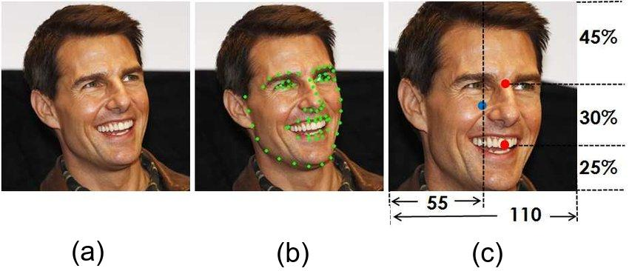
Dataset Construction
Part 1 - Face Recognition
We avoided time-consuming construction of datasets, using a technique that combines the manual labelling (i.e OpenCV-Video-Label annotation tool) of a small amount of data with AL methods.
DATASET: 10 classes
Then, we applied face alignment (i.e rotation, scaling, translation of facial landmarks) on training samples in order to achieve the optimal recognition accuracy.
Nextly, we converted the current dataset to encodings. Dlib is responsible for generating a feature vector per image sample.
Hence, we built a matrix where we appended all the training samples.
Example of face alignment.

Slide 11
Dataset Construction
Part 2 - Object Detection
We attempted to build two individual datasets:
5 different object classes
a single object class (surgery mask)
The data construction process was totally based on the usage of the OpenCV-Video-Label annotation tool.
The dataset that has been constructed contains image samples and xml files, which contain the class name and the precise bounding box coordinates that encloses the object within every image.

Slide 12
Face Recognition: Classifier Training
After generating faces encodings, an ML classifier is being trained, in order to make probabilistic predictions for every detected face in the input video.
Training is being conducted on encodings in association to the corresponding class name.
According to bibliography, Support Vector Machines (SVM) and K-Nearest Neighbours (KNN) have been proven the most efficient classifiers for encodings classification.
Therefore, we conducted a classifier comparison between SVM and KNN and we decided that the optimal classifier - in terms of time and accuracy - is SVM.
Also, we observed that the class number reflects on results.
extremely low class number (e.g < 5) could cause an increase of FP predictions,
extremely high class number could result in significant delay during the FR sub-process.
Hence, we further experimented with the class number through the SVM training process as well as the recognition process.

Slide 13
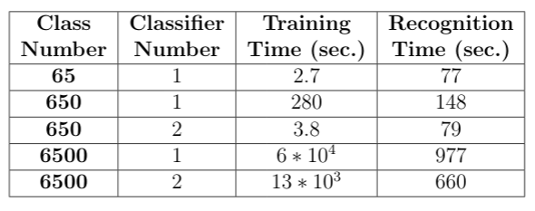
The above table shows training and recognition time for the same input but different class numbers.
For the cases of 650 and 6500 classes we attempted to train two individual classifiers instead of one.
We decided that the total number of classes per classifier shouldn't exceed 600, in order to avoid time-consuming sub-processes.
Finally, we noticed that splitting a heavy data set to two or more classifiers addressed the delay issues, for both training and recognition processes.

Slide 14
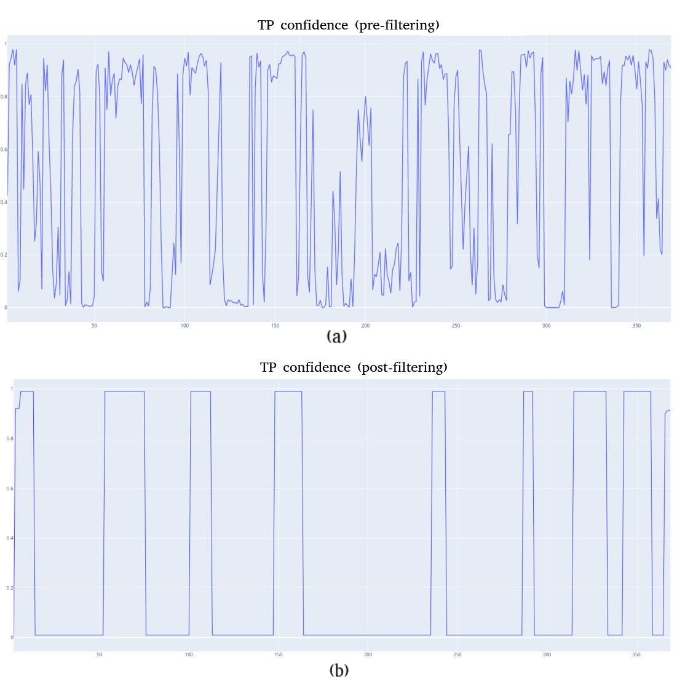
Face Recognition: Predictions Filtering
For every detected face in a frame the classifier predicts a probability value (confidence) for each class in the data set.
Face identification results from the highest confidence value among all classes.
Prediction flickering (i.e inconsistency of face identification through frames) is a common phenomenon in most FR systems.
Thus, we incorporated a filtering algorithm.
The next figure shows the confidence diagram for a TP case. After applying the algorithm, the confidence values have been smoothed, while the flickering phenomenon has been eliminated.

Slide 15
Face Recognition: Output
As soon as an input video is being proceed for facial recognition, we extract knowledge for both “known” faces (i.e dataset classes) and “unknown” faces, which are not included in the dataset, yet.
When the FR process finishes, we export:
The actual frames as well as the precise coordinates, where the “known” faces have appeared.
The “known” faces in the video followed by: i. a list of the frames where they appear and ii. their coordinates.
The encodings of the “unknown” faces that appear in the video followed by their coordinates.
An annotated video.
As a result, we have exploited the information about “unknown” faces. When an “unknown” class is being inserted in the dataset, an efficient AL method detects all its previous appearances in recent input videos and gives access to more images that could be used for further training.
In the same way, a “known” class could be enhanced with more samples that originates from predictions with high confidence values.

Slide 16
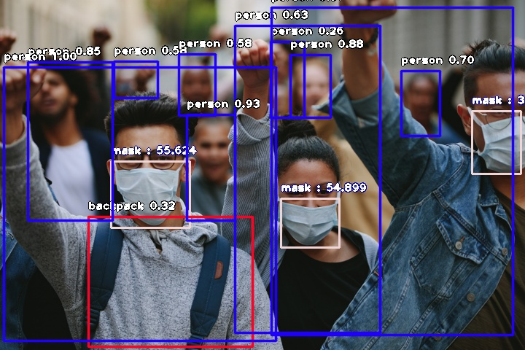
Object Detection: Training & Evaluation
ImageAI provides detailed documentation for object training on custom datasets.
During our experiments we concluded that the class number per custom training should not exceed 10 in order to achieve good results.
Training process ends when the validation loss stops decreasing and mAP score is not being significantly increased in comparison to previous epochs.
ImageAI enables saving epoch’s checkpoints and provides an evaluation method that estimates the mAP score, in order to find the optimal model between checkpoints.
We experimented with OD training making use of two different datasets
1-class (surgery mask - see picture)
5-classes (training on both ImageAI and Darknet)
Example of Object Detection with the trained mask model.
* mask detection score = 3/3
** people wearing mask = 20%

Slide 17
Object Detection: Output
During the prediction process on an input video, the “known” object classes are being identified only if their predicted probabilities are higher than a predefined tolerance value.
When the total OD process finishes, we export:
The precise coordinates of the bounding boxes as well as the confidence value per prediction.
The total number of object's instances per frame.
An annotated video.
Additionally, making use of AL techniques we have collected information about brand-new training samples as well as their precise position.
A handy scenario is enhancing the dataset with the samples that correspond to high confidence values.

Slide 18
Integrated System
Our implementation consists of a system that applies both FR and OD to an input video, in order to extract as much information as possible in real-time.
Furthermore, we succeeded in combining the system’s outputs, addressing the challenge of faces and objects association.
We built a list of personal objects (i.e wearables such as mask/tie or objects that a person could use such as cell phone/umbrella) and we utilized the bounding boxes of both faces and personal objects that have appeared in the same frame's region.
The output of such an association could be the following system log:
“Object with name: {X} belongs to a person with name {Y}”

Slide 19
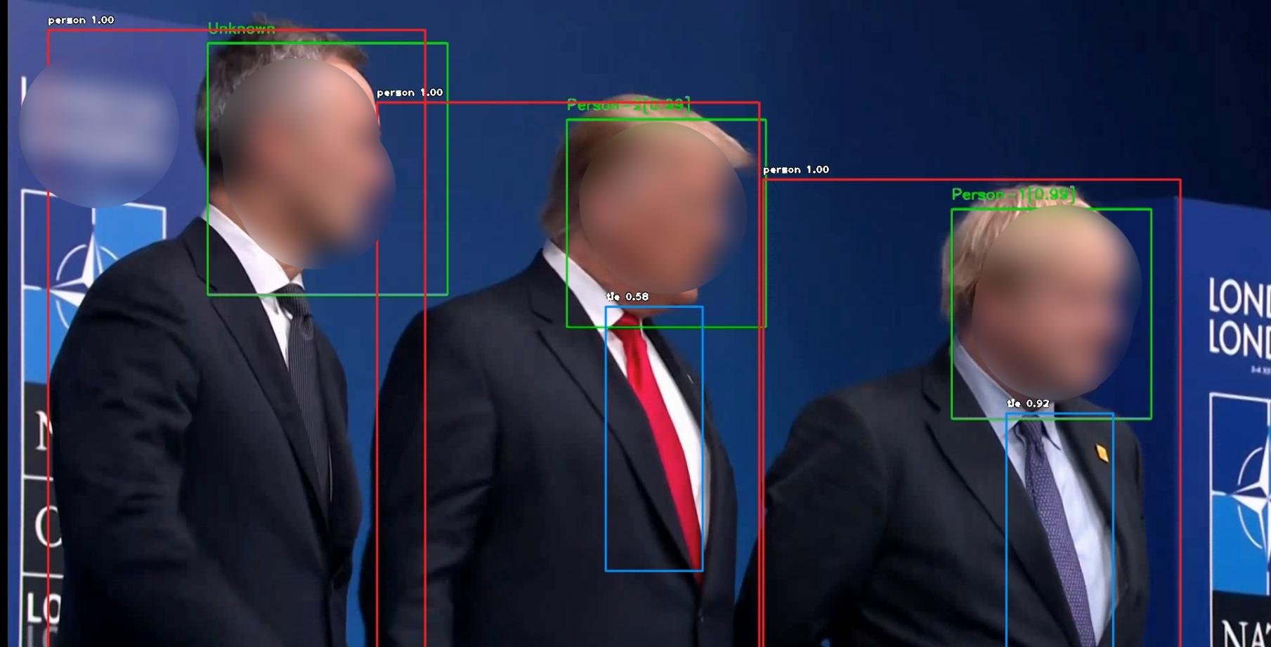
The extracted log for this frame would be the following:
Object with name: “tie” belongs to a person with name: “Person-1”.
Example of the total information about both the faces and objects that have appeared in a random frame from an input video that undergoes our system.

Slide 20
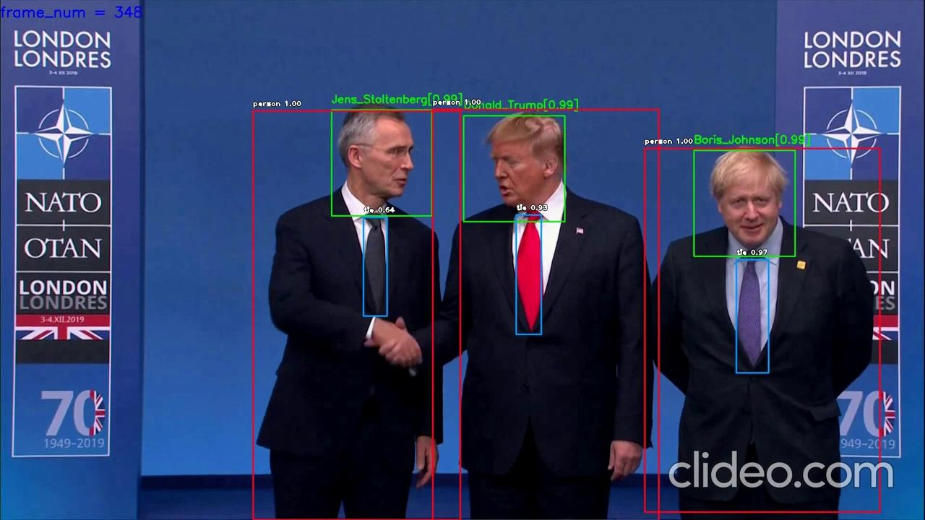
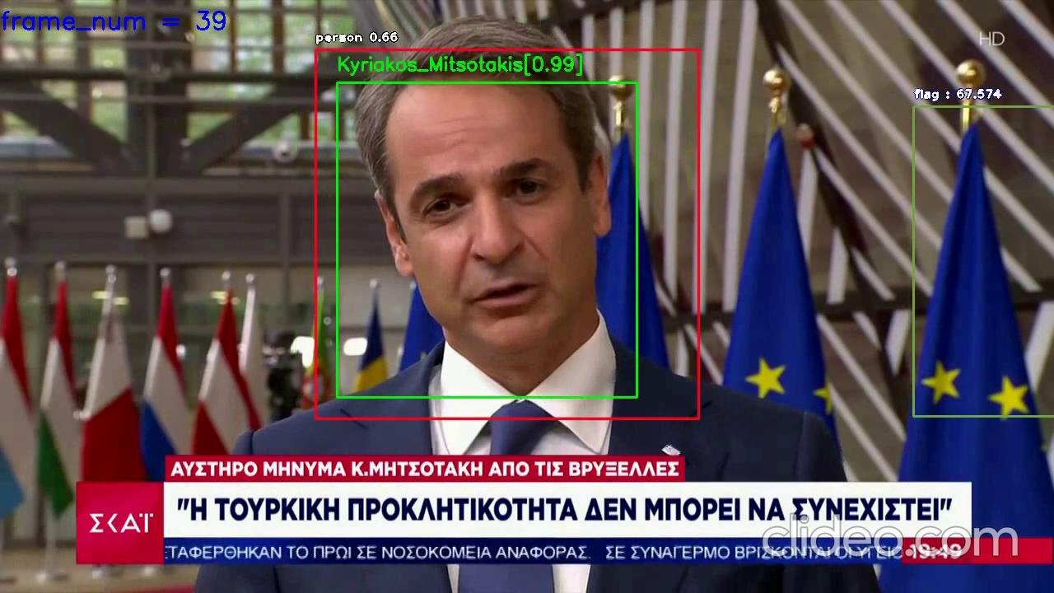
Example of full-annotated output videos with frame rate = 2 frames per second.

Slide 21
Metadata Repository
Meanwhile, we built a metadata repository that consists of details about every input that undergoes the system as well as system's variables:
unique id, duration, frame rate, etc
class number (per model)
output/logs
Every time we "send" a input video for FR and OD, the system searches in the records, in order to check if the current input - with the predefined parameters - has already undergone the system.
Hence, we succeed:
to extract and preserve the whole information
to avoid multiple execution of the system for the same input video and pre-defined parameters

Slide 22
Future Challenges
There are several challenges for future research:
The proposed method addresses only face to objects associations.
Further associations between either individual faces or individual objects could be incorporated in order to extract statistics about persons or objects' common appearance in videos.
Including features that satisfy additional use-cases:
Color analysis algorithm: color palette per frame (dominant colors)
Image prediction model: automatic tags generation per frame.
Estimation of tag variability through the video.
Determination of possible correlation between the frames' contents, the generated tag and the dominant colors.

Slide 23
Thank you for your attention!
QUESTIONS ???

